Slide 1
User Interface Design
ABHISHEK BHATTACHARYA,IEM

Slide 2
Introduction
In any software product,
  user interface portion is responsible for all interactions with the user.
Almost every software product has a user interface:
  can you think of any software product that does not have any user interface?

Slide 3
Introduction
In the early days of computer, no software product had any user interface:
  all computers were batch systems
  no interactions with users were supported.
We know that things are very different now:
  almost every software product is highly interactive.

Slide 4
Introduction
Users interact with a software product through its user interface:
  user-interface portion of any software is directly relevant to the users.
  many users judge a software from its user interface.
User interface design:
  a practical and important problem.

Slide 5
Introduction
A difficult to use interface:
  leads to higher levels of user errors
  leads to user dissatisfaction.
Users become particularly irritated when a system behaves in unexpected ways,
  issued commands do not carry out actions according to intuitive expectations of users.

Slide 6
Introduction
A significant portion of the total development effort:
  spent in developing the user interface.
For many interactive applications:
  as much as 50% of the total development effort is spent on the user interface part.

Slide 7
Introduction
If the user interface is not developed systematically:
  effort required to develop the interface would increase tremendously :
    leading to customer dissatisfaction.

Slide 8
Introduction
It is important to carefully study
  user interface design concepts.
Let us examine what a good interface is:
  Unless we know what a good user interface really is,
    we cannot possibly design one.

Slide 9
Characteristics of Good User Interfaces
Speed of learning:
  A good user interface should be simple to learn.
  Most users are put off by complex syntax and semantics of the command issue procedures.

Slide 10
Speed of learning
A good user interface should not require
  users to memorize commands.
An important factor affecting the speed of learning is consistency:
  Once, a user learns about a command,
  should be able to use similar commands
    even in different circumstances for carrying out similar actions.

Slide 11
Speed of learning
Users can learn about an interface faster, if it is based on:
  day-to-day real life examples (aka metaphors)
  use concepts with which users are already familiar.

Slide 12
Speed of learning
For example, interface of a text editor:
  can use concepts similar to writing on paper:
    such as cutting lines and paragraphs and pasting it at other places,
    users can immediately relate to it.
Also, learning is facilitated by:
  intuitive command names
  symbolic command issue procedures.

Slide 13
Speed of use
Speed of use is determined by:
  the time and effort necessary to initiate and execute different commands.
  The time and user effort necessary to execute different commands should be minimal.

Slide 14
Speed of use
Examples of bad interfaces:
  users required to type in lengthy commands
  command issue involves moving the mouse to widely different areas of the screen
  can slow down the operating speed of users.

Slide 15
Speed of recall
Once users learn how to use an interface:
  their speed of recall about using the interface should be maximized.
The speed of recall is improved if the interface is based on:
  metaphors
  symbolic command issue procedures
  intuitive command names.

Slide 16
Error rate
A good user interface should
  minimize the scope of committing errors.
Error rate can be easily measured:
  count the errors committed by different users.

Slide 17
Error rate
Error monitoring can be automated:
  instrument user interface with monitoring code
  record the frequency and types of errors committed by different users
  later display statistics of various kinds of user errors.

Slide 18
How to reduce error possibilities?
Consistency of command names,
Consistency of command issue procedures,
Consistency in behavior of similar commands
Simplicity of command issue procedure, etc.

Slide 19
Attractiveness
A good user interface should be attractive:
  An attractive user interface catches user attention and fancy.
  In this respect,
    graphics-based user interfaces have a definite advantage over text-based interfaces.

Slide 20
Consistency
Consistency of commands is very desirable.
  allow users to generalize the knowledge about one aspect of the interface to another.
Consistency helps in:
  speed of learning,
  speed of recall,
  also helps in reduction of error rate.

Slide 21
Feedback
A good user interface must provide constant feedback to user actions:
  For example, if any user request takes more than few seconds to process,
    the user must be informed that his/her request is still being processed.
  If possible, the user should be periodically informed about the progress made in processing the command.

Slide 22
Feedback
In the absence of any response from the computer for a long time:
  a novice user might even start recovery/shutdown procedures in panic.

Slide 23
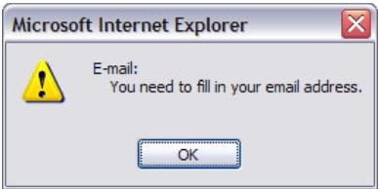
Feedback

Slide 24
Support for multiple skill levels
A good user interface:
  should support different levels of sophistication in command issue procedures:
  users with different experience levels prefer different types of interfaces.
Experienced users are more concerned about speed of command issue:
  whereas novice users pay prime importance to usability aspects.

Slide 25
Support for multiple skill levels
Novice users discouraged by:
  cryptic command names
  complex command issue procedures.
Elaborate commands:
  slow down command issue procedure
  put off experienced users.

Slide 26
Support for multiple skill levels
As users become familiar with an interface:
  look for faster command issue procedures such as "hot-keys", "macros", etc.

Slide 27
Error Recovery (Undo facility)
All categories of users commit errors.
  A good interface should allow users to undo mistakes..
Users are inconvenienced:
  if they can not recover from even simple errors.

Slide 28
User Guidance and On-line Help
Users might need guidance
  or seek help from the system.
User Guidance is provided through two broad category of methods:
  On-line help system
  Guidance and error messages produced
    in response to user actions.

Slide 29
On-line Help System
Generic help messages are not very useful:
  on-line help messages should be tailored to the context in which help is invoked.

Slide 30
On-line Help
A good on-line help should:
  provide messages in context-dependent way.
    keep track of what a user is doing
  help messages should be tailored to user's experience level.
  should take advantage of graphics capabilities of the screen
    not just be a copy of the user manual.

Slide 31
Guidance Messages
The guidance messages should be carefully designed:
  prompt the user:
    next actions he/she might take,
    current status of the system,
    progress made so far in processing the command

Slide 32
Guidance Messages
A good guidance system should have:
  different levels of sophistication for different categories of users.
  users should have an option to turn off detailed messages.

Slide 33
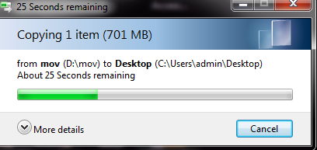
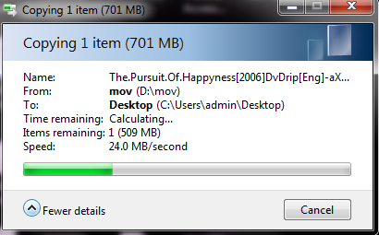
EXAMPLE

Slide 34
Error Messages
Error messages should be polite.
Error messages should not be associated with noise:
  might embarrass the user.
The messages should suggest how a given error can be rectified.

Slide 35
Error Messages
If appropriate,
  the user should be given the option of invoking on-line help
  to find out more about the error situation.

Slide 36

Improper Error Message
File not found!

Slide 37
Mode-Based versus Modeless Interface
A mode is a state or collection of states:
  in each state (or mode) different types of commands are available.
Modeless interface:
  same set of commands are available at all times.
Mode-based interface:
  different sets of commands are available depending on the mode in which the system is, i.e.
  based on the past sequence of the user commands.

Slide 38
Mode-Based versus Modeless Interface
A mode-based interface can be represented using a state transition diagram:
  each node (state) of the state transition diagram represents a mode.
  Every state (node) of the diagram
    annotated with command names meaningful in that state.

Slide 39
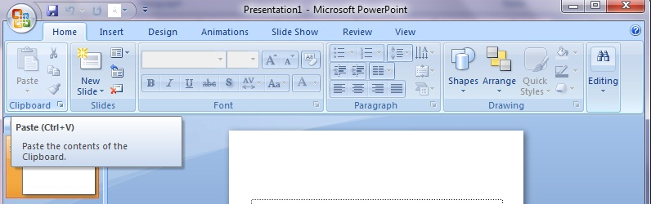

Slide 40
Graphical User Interface (GUI) versus Text-Based User Interface
In a GUI:
  several windows with different information can be simultaneously displayed on user’s screen.
  This is perhaps the biggest advantage of GUI
  user can simultaneously interact with several related items at any time
  can even run many unrelated applications

Slide 41
Graphical User Interface (GUI) versus Text-Based User Interface
Iconic information representation and symbolic information manipulation is possible in a GUI.
Symbolic information manipulation:
  such as pulling an icon representing a file into a trash can for deleting
  intuitively very appealing
    user can instantly remember it.

Slide 42
Graphical User Interface (GUI) versus Text-Based User Interface
A GUI can support command selection:
  using an attractive and user-friendly menu selection system.
In a GUI, a pointing device can be used:
  a mouse or a light pen to issue commands.
  The use of a pointing device
    makes command issue procedure simpler.

Slide 43
Graphical User Interface (GUI) versus Text-Based User Interface
On the flip side, a GUI requires:
  special terminals with graphics capabilities
  requires special input devices such a mouse.
In contrast, a text-based interface:
  can run even on cheap alphanumeric terminals:
  Graphics terminals are usually much more expensive than alphanumeric terminals.

Slide 44
Graphical User Interface (GUI) versus Text-Based User Interface
Increasing availability of:
  terminals with graphics capability
  bit-mapped high-resolution displays
  significant amount of local processing power.
We will concentrate our attention to GUIs

Slide 45
Types of User Interfaces
User interfaces can be classified into three categories:
  Command language-based interface
  Menu-based interface
  Direct manipulation interface

Slide 46
Types of User Interfaces
Each category of interface has its advantages and disadvantages:
  Modern applications sport a combination of all the three types of interfaces.

Slide 47
Choice of Interface
Which parts of the interface should be implemented using what type of interface?
  No simple guidelines available
  to a large extent depends on the experience and discretion of the designer.
  a study of characteristics of the different interfaces would give us some idea.

Slide 48
Command Language-Based Interface
As the name itself suggests:
  incorporates some language to form commands.
Users frame the required commands in the language:
  type them in whenever required.

Slide 49
Design of command language interface
Simple command language interface:
  determine all the commands needed to be supported
  assign unique names to the different commands.

Slide 50
Design of command language interface
A more sophisticated command language interface:
  allow users to compose primitive commands to form more complex commands.
    Consider cat x.dat|grep 123
  Like a programming language.

Slide 51
Command Language-Based Interface
The facility to compose commands:
  dramatically reduces the number of command names users would have to remember.
  Commands can be made concise
    requiring minimal typing by the user.
  allow faster interaction with the computer
  simplify input of complex commands.

Slide 52
Advantages of Command Language Interfaces
Easy to develop:
  compiler writing techniques are well developed.
Can be implemented even on cheap alphanumeric terminals.
Much more efficient:
  compared to other types of interfaces.

Slide 53
Disadvantages of Command Language Interfaces
Difficult to learn:
  Require the user to memorize primitive commands.
Require the user to type in commands.
Users make errors while:
  formulating commands in the command language
  typing them in.

Slide 54
Disadvantages of Command Language Interfaces
All interactions are through key-board:
  cannot take advantage of effective interaction devices such as a mouse.
  For casual and inexperienced users,
    command language interfaces are not suitable.

Slide 55
Issues in Designing a Command Language Interface
Design of a command language interface:
  involves several issues.
The designer has to decide
  what mnemonics are to be used for the commands.
  mnemonics should be meaningful
    yet be concise to minimize the amount of typing required.

Slide 56
Issues in Designing a Command Language Interface
The designer has to decide:
  whether users will be allowed to redefine command names to suit their own preferences.
    Letting a user define his own mnemonics for various commands is a useful feature,
    but increases complexity of user interface development.

Slide 57
Issues in Designing a Command Language Interface
Designer has to decide:
  whether it should be possible to compose primitive commands to create more complex commands.
  syntax and semantics of command composition options has to be clearly and unambiguously decided.

Slide 58
Issues in Designing a Command Language Interface
The ability to combine commands is a powerful facility for experienced users:
  but quite unnecessary for inexperienced users.

Slide 59
Menu-Based Interface
Advantages of a menu-based interface over a command language interface:
  users are not required to remember exact command names.
  typing effort is minimal:
    menu selections using a pointing device.
    This factor becomes very important for the occasional users who can not type fast.

Slide 60
Menu-Based Interface
For experienced users:
  menu-based interfaces is slower than command language interfaces
  experienced users can type fast
  also get speed advantage by composing simple commands into complex commands.

Slide 61
Menu-Based Interface
Composition of commands in a menu-based interface is not possible.
  actions involving logical connectives (and, or, all, etc.)
    awkward to specify in a menu-based system.

Slide 62
Menu-Based Interface
If the number of choices is large,
  it is difficult to design a menu-based interface.
  Even moderate sized software needs hundreds or thousands of menu choices.
A major problem with the menu-based interface:
  structuring large number of menu choices into manageable forms.

Slide 63
Structuring Menu Interface
Any one of the following options is adopted to structure menu items.
  Walking menu
  Scrolling menu
  Hierarchical menu

Slide 64
Scrolling Menu
  Used when the menu options are highly related.
    For example text height selection in a word processing software.
  Scrolling of menu items
    lets the user to view and select the menu items that can not be accommodated on one screen.

Slide 65
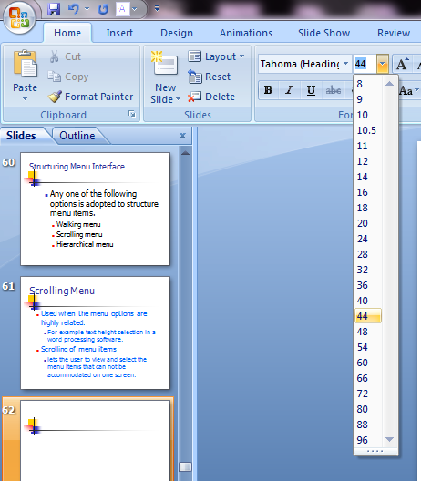
Scrolling Menu

Slide 66
Walking Menu
Walking menu is commonly used to structure large menu lists:
  when a menu item is selected,
  it causes further menu items to be displayed adjacent to it in a submenu.

Slide 67
Walking Menu
A walking menu can successfully structure commands only if:
  there are tens rather than hundreds of choices
  each adjacently displayed menu does take up some screen space
    the total screen area is after all limited.

Slide 68
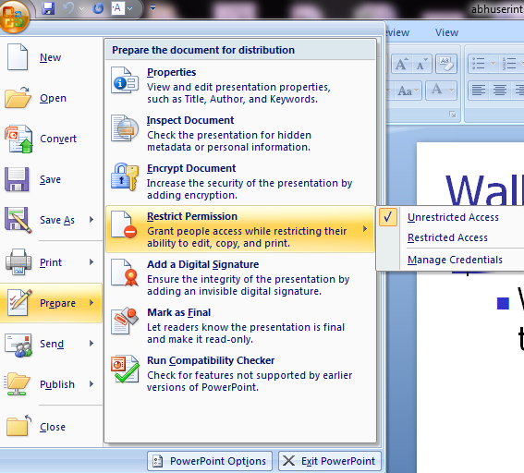
Walking Menu

Slide 69
Hierarchical menu
Menu items are organized in a hierarchy or tree structure.
  Selecting a menu item causes the current menu display to be replaced by an appropriate submenu.
  One can consider the menu and its various submenu to form a hierarchical tree-like structure.

Slide 70
Hierarchical menu
.
Hierarchical menu can be used to manage large number of choices,
  but, users face navigational problems
    lose track of where they are in the menu tree.

Slide 71
Direct Manipulation Interface
Present information to the user
  as visual models or objects.
Actions are performed on the visual representations of the objects, e.g.
  pull an icon representing a file into an icon representing a trash box, for deleting the file.
Direct manipulation interfaces are sometimes called as iconic interfaces.

Slide 72
Direct Manipulation (Iconic) Interface
Important advantages of iconic interfaces:
  icons can be recognized by users very easily,
  icons are language-independent.
However, experienced users consider direct manipulation interfaces too slow.

Slide 73
Direct Manipulation (Iconic) Interface
It is difficult to form complex commands using a direct manipulation interface.
For example, if one has to drag a file icon into a trash box icon for deleting a file:
  to delete all files in a directory one has to perform this operation again and again
  very easily done in a command language-interface by issuing a command delete *.*

Slide 74
Windowing Systems
Most modern GUIs are developed using some windowing system.
A windowing system can generate displays through a set of windows.
Since a window is a basic entity in such a graphical user interface:
  we need to first discuss what exactly a window is.

Slide 75
Window
A window is a rectangular area on the screen.
A window is a is a virtual screen:
  it provides an interface to the user for carrying out independent activities,
  one window can be used for editing a program and another for drawing pictures, etc.
A window can be divided into two parts:
  client part,
  non-client part.

Slide 76
Window
The client area makes up the whole of the window,
  except for the borders and scroll bars.
The client area is available to the programmer.
Non-client area:
  under the control of window manager.

Slide 77
Window management system (WMS)
A graphical interface might consist of a large number of windows,
  necessary to have some systematic way to manage the windows.
  Window Management System (WMS)

Slide 78
Window management system (WMS)
GUIs are developed using a window management system (WMS):
  A window management system is primarily a resource manager.
  keeps track of screen area resource
  allocates it to the different windows which are using the screen.

Slide 79
Window management system (WMS)
From a broader perspective, a WMS can be considered as a user interface management system (UIMS) ---
  not only does resource management,
  also provides the basic behavior to windows
  provides several utility routines to the application programmer for user interface development.

Slide 80
Window management system (WMS)
A WMS simplifies the task of a GUI designer to a great extent:
  provides the basic behavior to the various windows such as move, resize, iconify, etc.
  provides routines to manipulate windows such as:
    creating, destroying, changing attributes of the windows, and drawing text, lines, etc.

Slide 81

Window management system (WMS)
A WMS consists of two part:
  a window manager
  a window system.
Window Manager
Application Program
WMS
Window System

Slide 82
Window Manager and Window System
User interacts with window manager to do various window-related operations such as:
  window repositioning,
  window resizing,
  iconification, etc.
Window manager also controls the screen’s real estate policy.

Slide 83
Window manager
The window manager is built on the top of the window system:
  makes use of the basic services provided by the window system.
The window manager determines how the windows look and behave.
  several kinds of window managers can be based on the same window system.

Slide 84
Window manager
Window manager can be considered as a special program:
  makes use of the services (function calls) of the window system.
Application programs
  invoke the window system for user interface-related functions.

Slide 85
Window System
Provides a large number of routines for the programmer
It is very cumbersome to use these large set of routines:
  most WMS provide a higher-level abstraction called widgets.

Slide 86
Window Management System
A widget is the short form for a window object.
Widgets are the building blocks in interface design.
We know that an object is essentially a collection of:
  related data with several operations defined on these data.

Slide 87
Widgets
The data of an window object are:
  the geometric attributes (such as size, location etc.)
  other attributes such as its background and foreground color, etc.
The operations defined on these data include, resize, move, draw, etc.

Slide 88
Summary
User interface is an important component of any software product.
We first discussed some important concepts associated with user interface design.
We discussed some desirable properties of a good user interface.

Slide 89
Summary
There are 3 main types of interfaces:
  command language interface
  menu-based interface
  iconic interface
Each type of interface has its own advantages and disadvantages:
  most modern interfaces use a combination of all the three types.

Slide 90
Summary
We finally discussed concepts associated with a window management system (WMS):
  consists of a window manager and a window system.
  we discussed the use of widgets as the basic building blocks in GUI design.

Slide 91
A STORY
A software developer/tester convention was being held.
On the train to the convention, there were a bunch of developer majors and a bunch of tester majors.
Each of the developer majors had his/her train ticket. The group of testers had only ONE ticket for all of them.
The developer majors started laughing and snickering.
Then, one of the software testers said, “here comes the conductor” and then all of the testers went into the bathroom.

Slide 92
Continued..
The developer majors were puzzled. The conductor came aboard and said “tickets please” and got tickets from all the developer majors. He then went to the bathroom and knocked on the door and said “ticket please” and the testers stuck the ticket under the door. The conductor took it and then the testers came out of the bathroom a few minutes later. The developer majors felt really stupid. So, on the way back from the convention, the group of developer majors had one ticket for the group

Slide 93
Continued
They started snickering at the testers, for the whole group had no tickets amongst them. Then, the tester lookout said “Conductor coming!” All the testers went to one bathroom. All the developer majors went to another bathroom. Then, before the conductor came on board, one of the testers left the bathroom, knocked on the other bathroom, and said “ticket please.”
Lesson learned: Any test that passed in unit testing can fail in system testing

